Slide 1
I want some of that PWA everyone is talking about
Yaser Adel Mehraban
Feb 2018

Slide 2



Yaser Adel Mehraban
Passionate Software Engineer
Blogger
Technologist
Senior Consultant @Readify
https://blog.mehraban.com.au
@yashints

Slide 3

What's on the menu
History
What is a Progressive Web App?
Browser support
Key components
Lighthouse
App manifest
Angular and PWA
Angular ServiceWorker (ngsw)
Under the hood
Push notifications

Slide 4








A bit of history
Mid 80’s
Clients applications
Mid 90’s
Web applications
Mid 00’s
Mobile applications

Slide 5
What is a PWA?
In 2015, designer Frances Berriman and Google Chrome engineer Alex Russell coined the term "progressive web apps“
"are regular web pages or websites“
Attempts to combine features offered by most modern browsers with the benefits of mobile experience.

Slide 6
Main characteristics
Progressive
Responsive
Connectivity independent
App-like interaction
Fresh
Safe
Discoverable
Re-engageable
Installable
Linkable
Notes:
Progressive - Work for every user, regardless of browser choice because they’re built with progressive enhancement as a core tenet.
Connectivity independent - Service workers allow work offline, or on low quality networks.
Safe - Served via HTTPS to prevent snooping and ensure content hasn’t been tampered with.
Re-engageable - Make re-engagement easy through features like push notifications

Slide 7
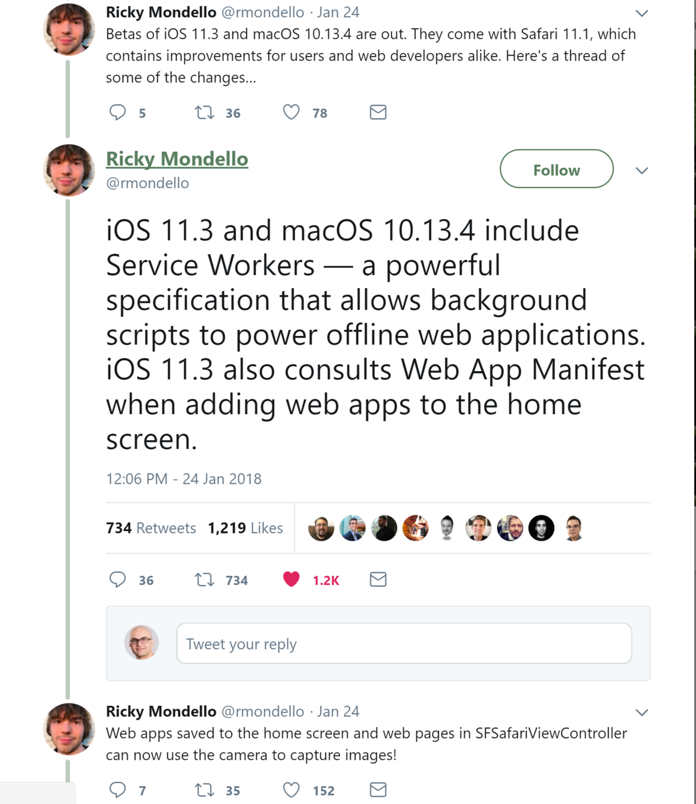
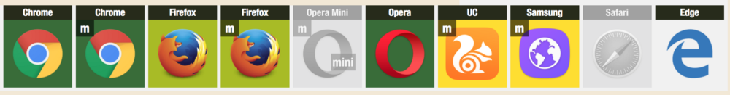
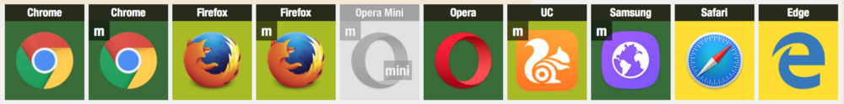
Browser support
Beginning of the last year
Start of this year
Images from : https://ispwaready.toxicjohann.com

Slide 8
Key components
Service Worker
Application
Manifest
App Shell
Notes:
A service worker is a script that your browser runs in the background
Multiple life cycles
Installable
Network proxy
Cache
Push notification
App shell => first meaningful interaction

Slide 9

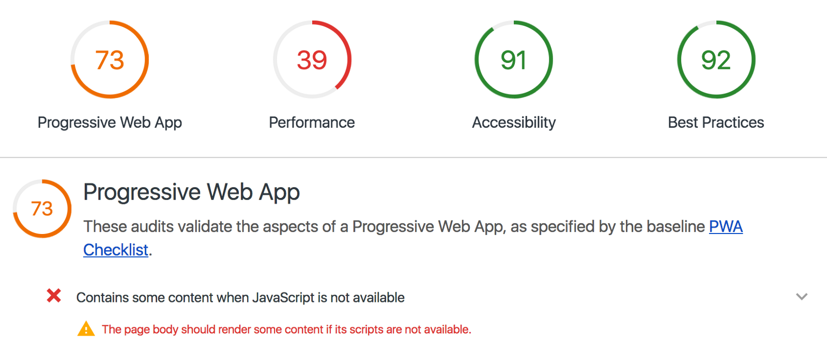
Lighthouse
Integrated in Chrome Dev Tools
Audit & report

Slide 10
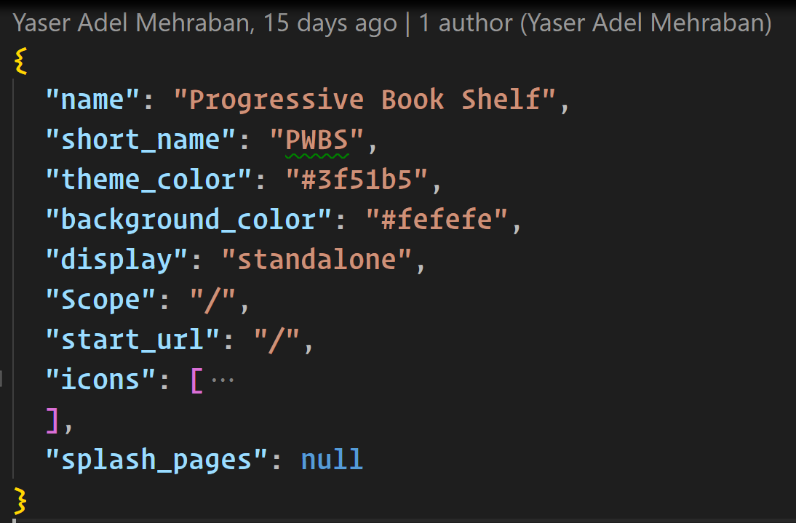
Application manifest

Slide 11

Angular PWAs
Manual
New Angular service worker (aka ngsw)
from v5.0.0.0
3rd party libs

Slide 12
ServiceWorkerModule
Registers the Angular Service Worker in the browser (if Service Worker support is available)
SwUpdate: for managing application version updates
SwPush: for handling server Web Push notifications

Slide 13
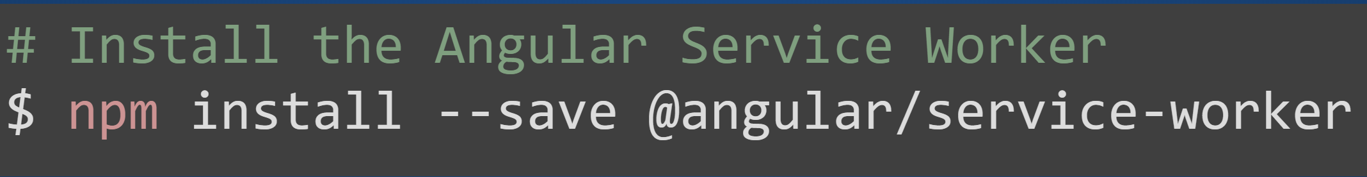
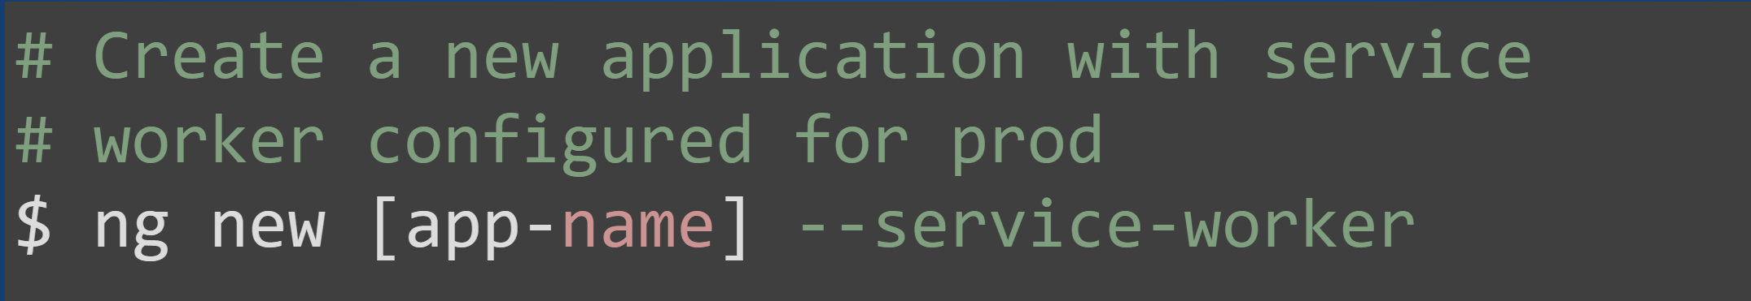
Setup

Slide 14
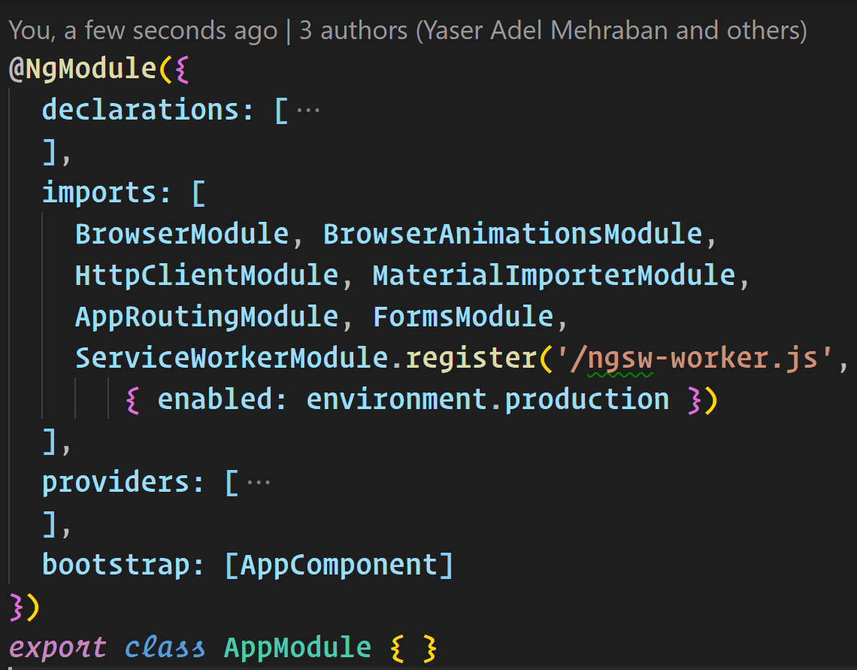
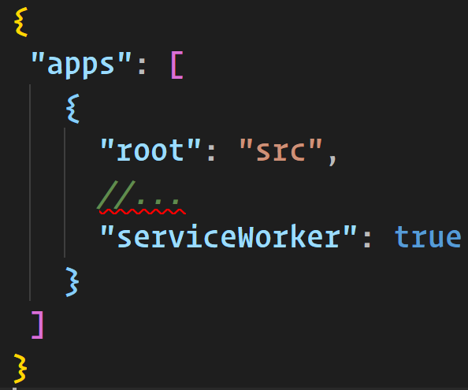
Under the hood

Slide 15
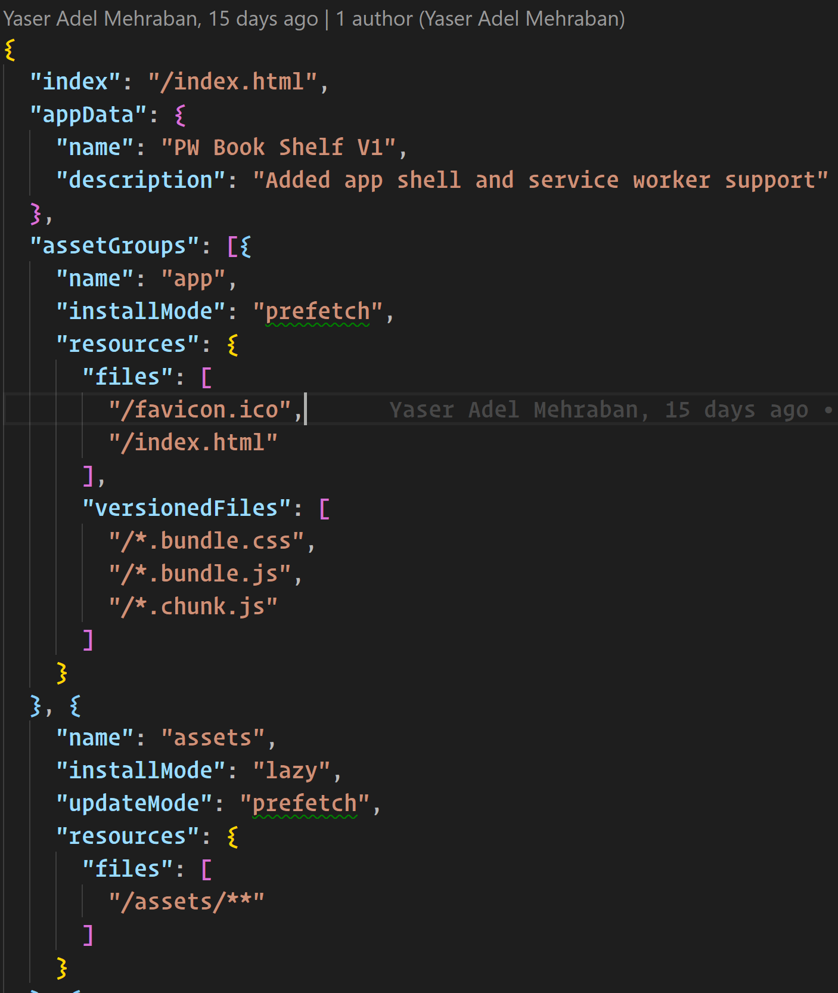
ngsw-config.json

Slide 16
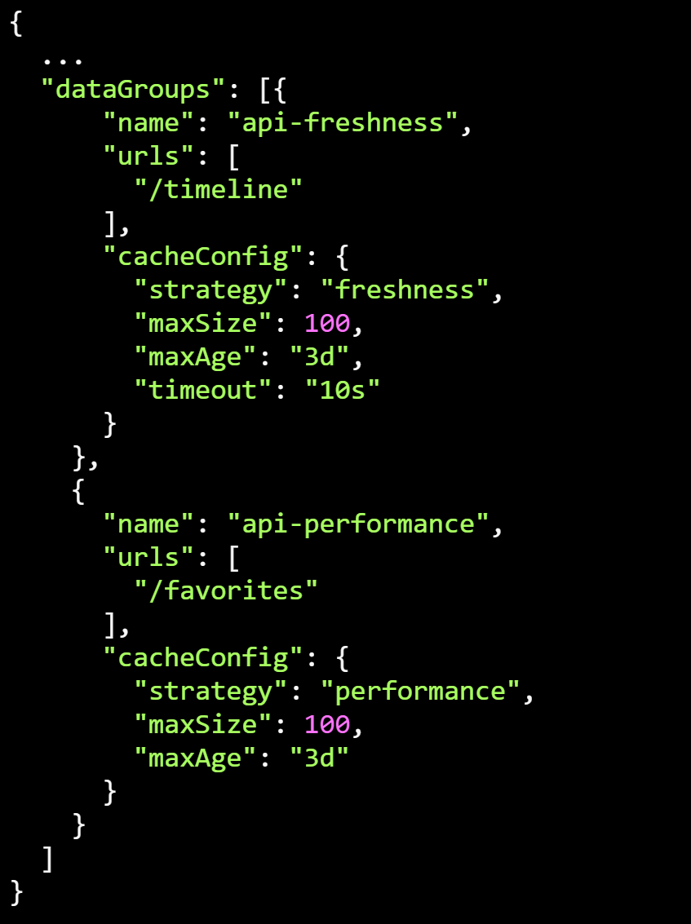
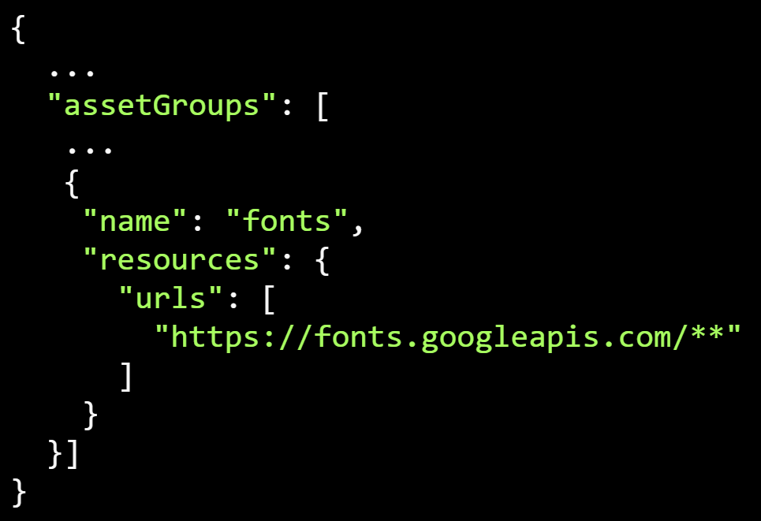
Caching other resources
Fonts / CDN based resources
API calls / Data

Slide 17

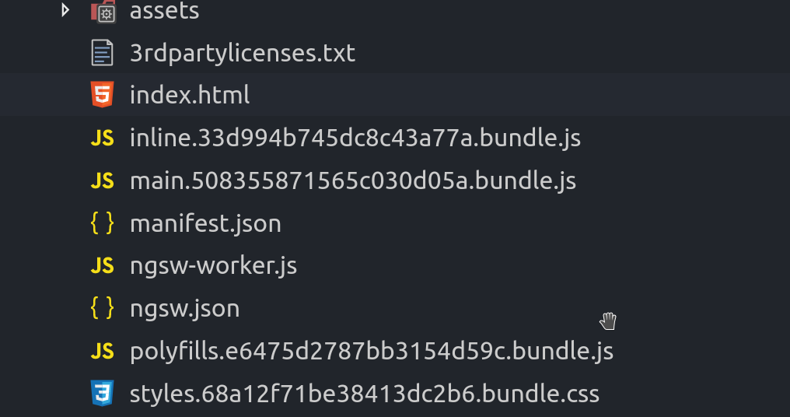
Build

Slide 18
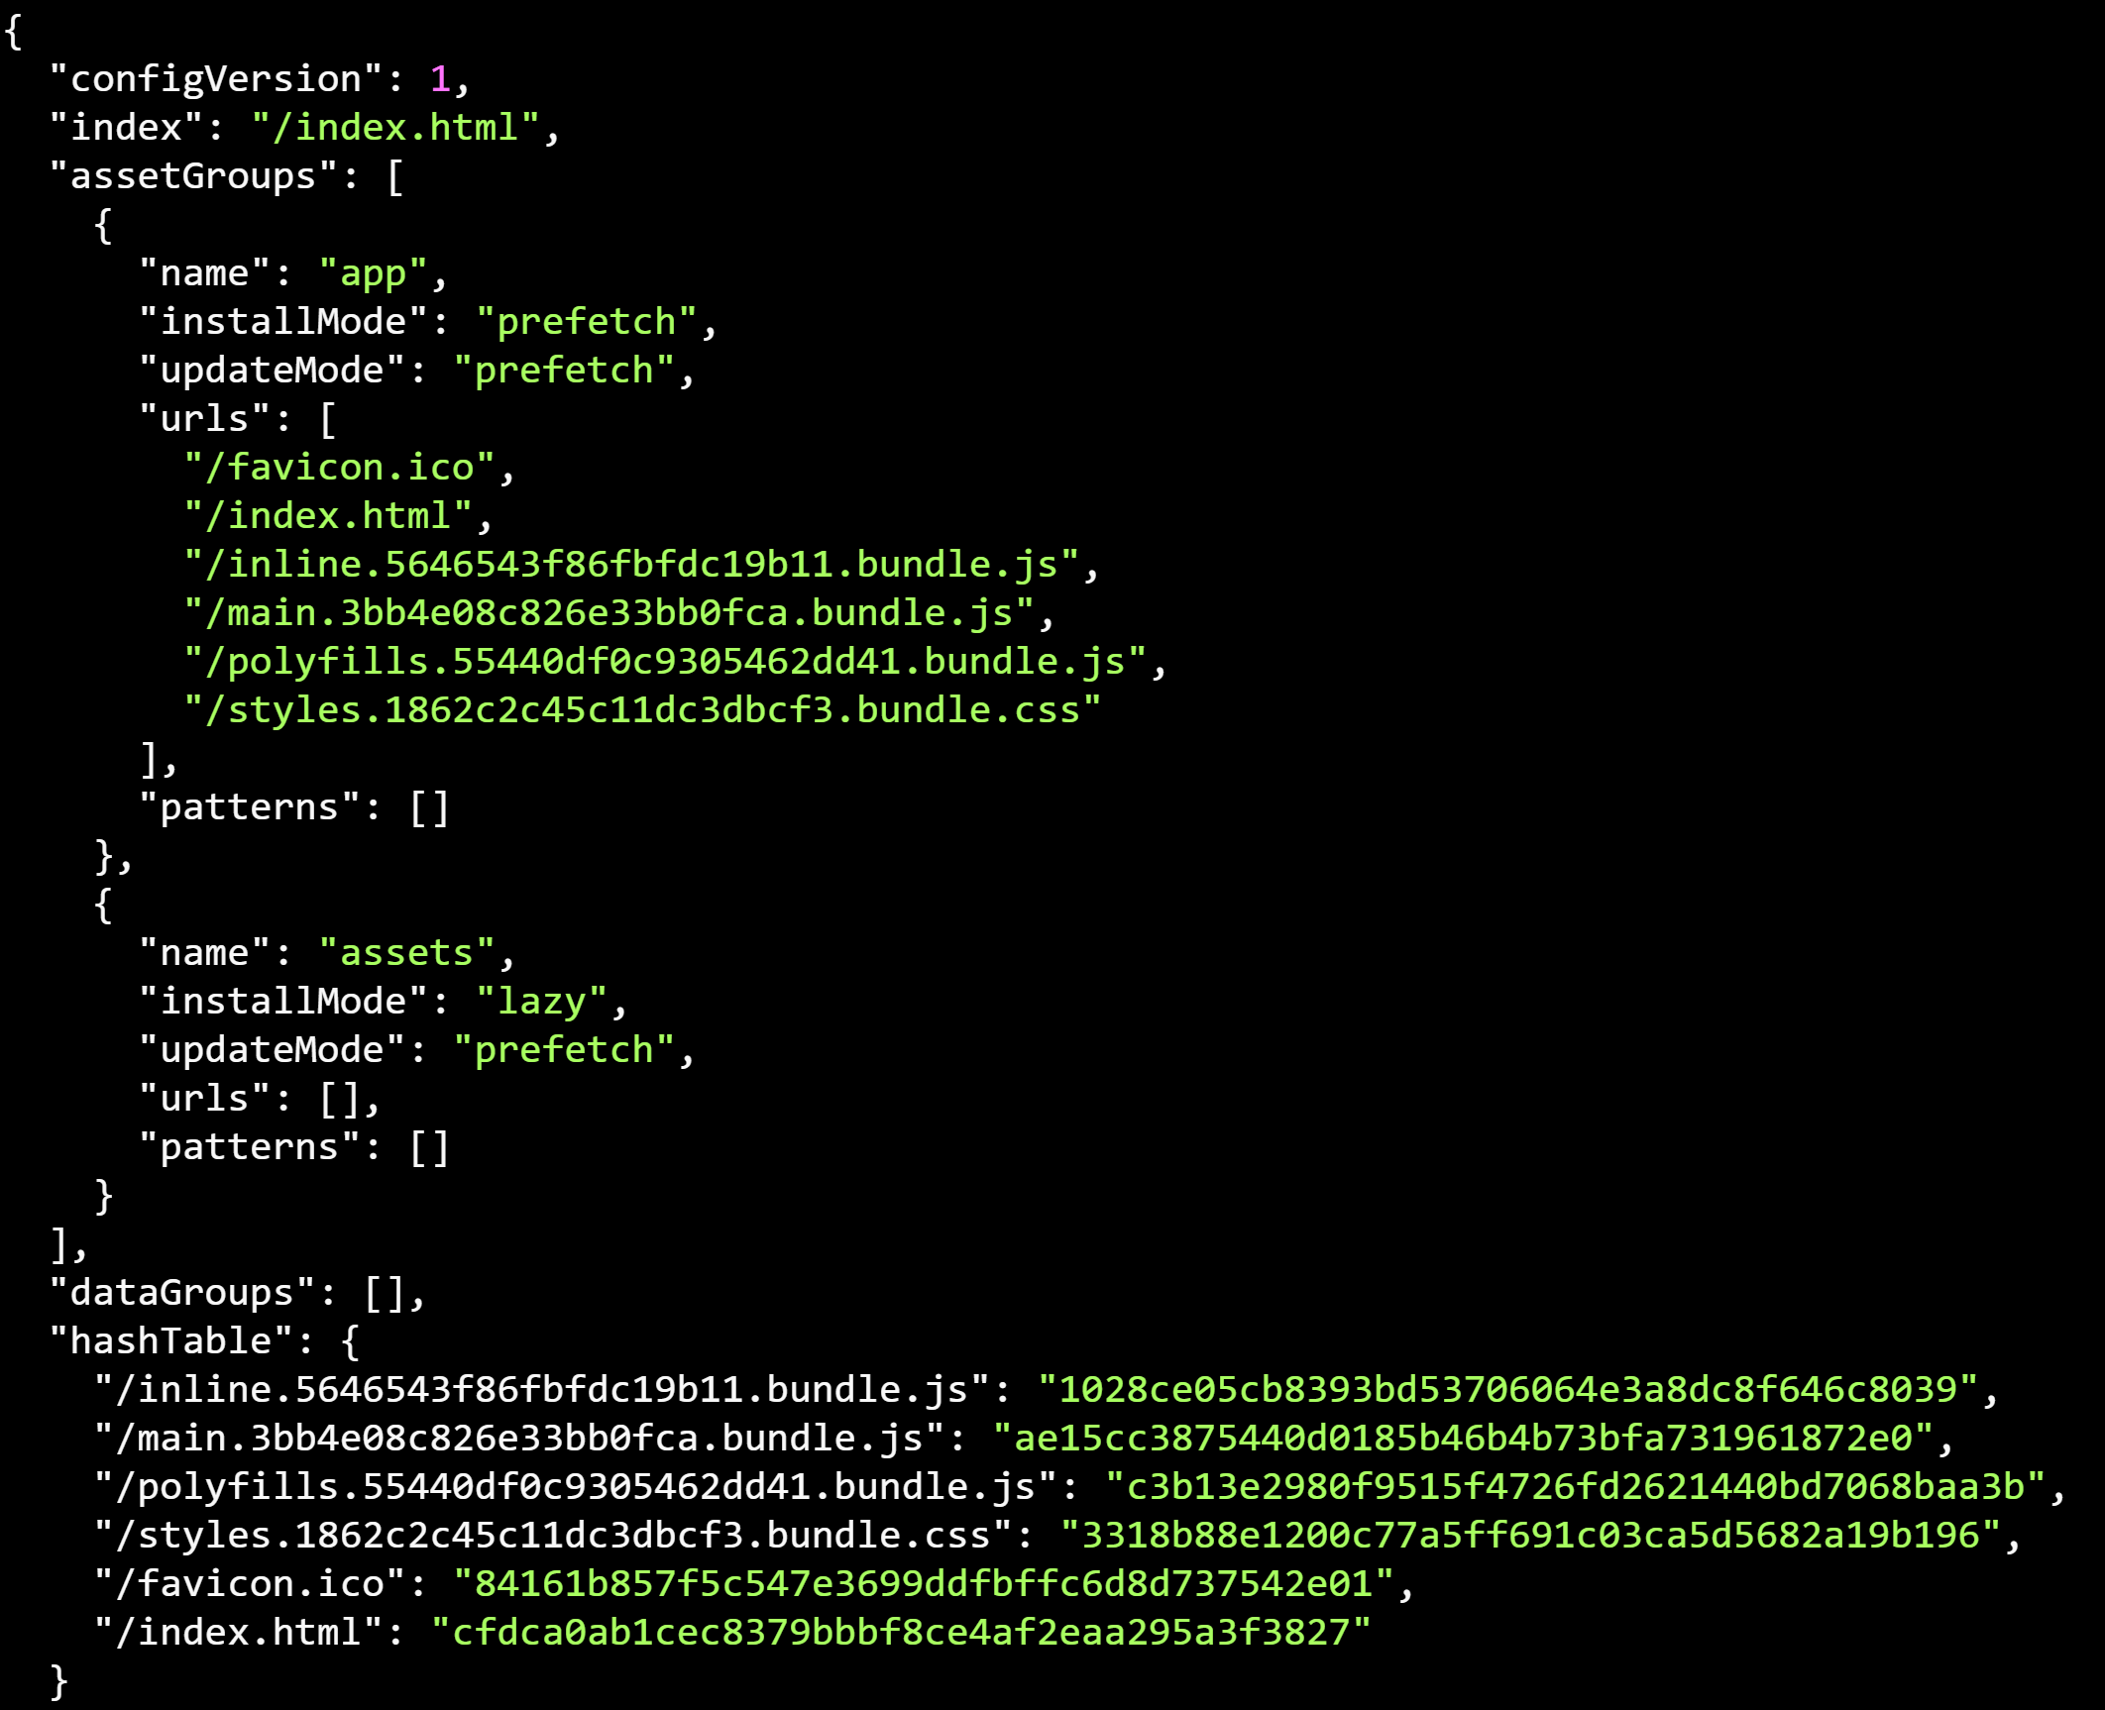
ngsw.json

Slide 19
ngsw-worker.js
Has its own http request
Will always be the same with each build, as it gets copied by the CLI straight from node_modules.
Remains the same until you upgrade to a new Angular version that contains a new version of the Angular Service Worker

Slide 20
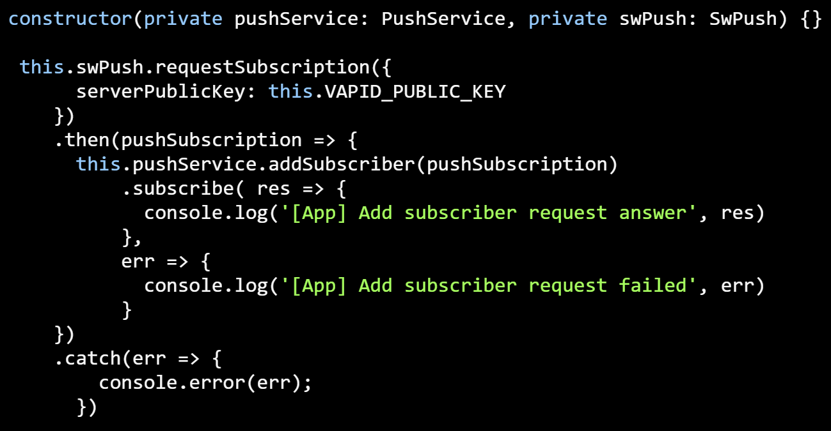
Push notifications
VAPID: Voluntary Application Server Identification

Slide 21
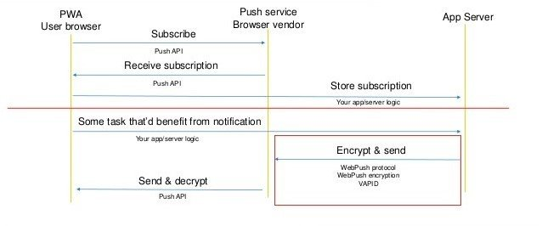
Push notifications

Slide 22
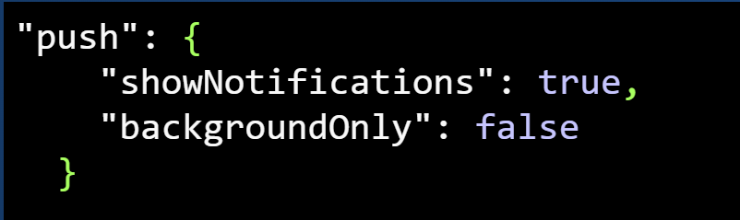
Push notifications
You nee to send notification data straight away with the send notification request as payload
ngsw can’t request this payload later, which is possible in general
You have to send this data object in the notification property of the payload.
Add to ngsw-manifest.json

Slide 23

Summary

Slide 24
Thank you!
@yashints

